Slide 1
Drawing outer 1-planar graphs with few slopes
Emilio Di Giacomo, Giuseppe Liotta, Fabrizio Montecchiani
Università degli Studi di Perugia
22nd International Symposium on Graph Drawing
24-26 September 2014, Würzburg, Germany

Slide 2
Problem definition, motivation, and results

Slide 3
The (Planar) Slope Number of a Graph G
minimum number of edge slopes to compute a (planar) straight-line drawing of G

Slide 4
The (Planar) Slope Number of a Graph G
minimum number of edge slopes to compute a (planar) straight-line drawing of G
v
G
u

Slide 5
The (Planar) Slope Number of a Graph G
minimum number of edge slopes to compute a (planar) straight-line drawing of G
v
v
G
u
u

Slide 6
The (Planar) Slope Number of a Graph G
minimum number of edge slopes to compute a (planar) straight-line drawing of G
v
v
G
psl(G)=5
u
u

Slide 7
The (Planar) Slope Number Problem
Given a family of (planar) graphs, find upper and lower bounds on the (planar) slope number of any graph G in the family

Slide 8
The (Planar) Slope Number Problem
Given a family of (planar) graphs, find upper and lower bounds on the (planar) slope number of any graph G in the family
we focus on graphs of bounded degree Δ
$\left\lceil \frac{\text{Δ}}{2}\right\rceil$≤ sl(G) ≤ m

Slide 9
Motivation and State of the Art

Slide 10
Motivation and State of the Art
Bounded-degree non-planar graphs can have arbitrarily large slope number (unbounded in $\text{Δ}$) [Barát et al.,The Electr. J. of Combin., 2006] [Pach, Pálvölgyi,The Electr. J. of Combin., 2006]

Slide 11
Motivation and State of the Art
Bounded-degree non-planar graphs can have arbitrarily large slope number (unbounded in $\text{Δ}$) [Barát et al.,The Electr. J. of Combin., 2006] [Pach, Pálvölgyi,The Electr. J. of Combin., 2006]
Planar bounded-degree graphs have bounded planar slope number - psl(G)∈ O(2^{O(Δ)}) - [Keszegh et al., SIAM J. Discrete Math., 2013]

Slide 12
Motivation and State of the Art
Bounded-degree non-planar graphs can have arbitrarily large slope number (unbounded in $\text{Δ}$) [Barát et al.,The Electr. J. of Combin., 2006] [Pach, Pálvölgyi,The Electr. J. of Combin., 2006]
Planar bounded-degree graphs have bounded planar slope number - psl(G)∈ O(2^{O(Δ)}) - [Keszegh et al., SIAM J. Discrete Math., 2013]
Is the slope number of “nearly-planar” graphs bounded in Δ ?

Slide 13
Motivation and State of the Art
The planar s. n. of planar partial 3-trees is O(Δ⁵) [Jelínek et al.,Graphs & Combinatorics, 2013]

Slide 14
Motivation and State of the Art
The planar s. n. of planar partial 3-trees is O(Δ⁵) [Jelínek et al.,Graphs & Combinatorics, 2013]
The planar s. n. of partial 2-trees is ϴ(Δ) [Lenhart et al., GD 2013]

Slide 15
Motivation and State of the Art
The planar s. n. of planar partial 3-trees is O(Δ⁵) [Jelínek et al.,Graphs & Combinatorics, 2013]
The planar s. n. of partial 2-trees is ϴ(Δ) [Lenhart et al., GD 2013]
Can this gap be reduced for subfamilies of planar partial 3-trees?

Slide 16
Our research
outer 1-planar graphs: graphs that admit drawings where each edge is crossed at most once and each vertex is on the boundary of the outer face

Slide 17
Our research
there exists a linear-time algorithm for testing outer 1-planarity (returns an o1p embedding)
[Auer et al., GD 2013] [Hong et al., GD 2013]
K₄
o1p drawing

Slide 18
Our research
there exists a linear-time algorithm for testing outer 1-planarity (returns an o1p embedding)
o1p graphs are planar partial 3-trees
[Auer et al., GD 2013] [Hong et al., GD 2013]
K₄
o1p drawing
planar drawing

Slide 19
Results
The o1p slope number, o1p-sl(G), of o1p graphs with maximum degree Δ is at most 6Δ +12
- This result also generalizes the result on the planar s. n. of outerplanar graphs which is Δ – 1 [Knauer et al., CGTA, 2014]

Slide 20
Results
The o1p slope number, o1p-sl(G), of o1p graphs with maximum degree Δ is at most 6Δ +12
- This result also generalizes the result on the planar s. n. of outerplanar graphs which is Δ – 1 [Knauer et al., CGTA, 2014]
The planar slope number of o1p graphs with maximum degree Δ is O(Δ²)

Slide 21
Results
The o1p slope number, o1p-sl(G), of o1p graphs with maximum degree Δ is at most 6Δ +12
- This result also generalizes the result on the planar s. n. of outerplanar graphs which is Δ – 1 [Knauer et al., CGTA, 2014]
The planar slope number of o1p graphs with maximum degree Δ is O(Δ²)

Slide 22
Overview of proof technique

Slide 23
Overview of proof technique
Prove o1p-sl(G) ≤ 6 Δ for 2-connected o1p graphs

Slide 24
Overview of proof technique
Prove o1p-sl(G) ≤ 6 Δ for 2-connected o1p graphs
Extend the result to 1-connected o1p graphs

Slide 25
Overview of proof technique
Prove o1p-sl(G) ≤ 6 Δ for 2-connected o1p graphs
Extend the result to 1-connected o1p graphs

Slide 26
Overview of proof technique
Prove o1p-sl(G) ≤ 6 Δ for 2-connected o1p graphs
Ingredients:
a universal set of slopes
bottom-up visit of SPQR-tree

Slide 27
A universal set of slopes

Slide 28
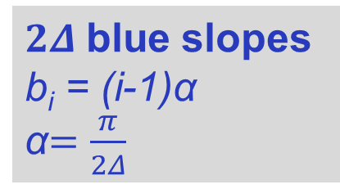
A universal set of slopes
$2Δ$blue slopes b_{i} = (i-1)α
α$=\frac{π}{2Δ}$
b$Δ$₊₁
b₁

Slide 29
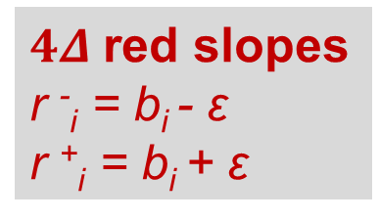
A universal set of slopes
$2Δ$blue slopes b_{i} = (i-1)α
α$=\frac{π}{2Δ}$
$4Δ$red slopes r ⁻_{i} = b_{i} - ε
r ⁺_{i} = b_{i} + ε
b$Δ$₊₁
r ⁺₁
b₁
r ⁻₁

Slide 30
A universal set of slopes
$2Δ$blue slopes b_{i} = (i-1)α
α$=\frac{π}{2Δ}$
$4Δ$red slopes r ⁻_{i} = b_{i} - ε
r ⁺_{i} = b_{i} + ε
b$Δ$₊₁
r ⁺₁
b₁
r ⁻₁
In the following: edges using blue (red) slopes will never (always) receive crossings

Slide 31
SPQR-tree decomposition
G is a 2-connected outer 1-plane graph
Recursive decomposition based on the split pairs into its triconnected components
G
Four types of nodes: S,P,Q,R

Slide 32
SPQR-tree decomposition
T
Q
P
P
S
S
Q
P
Q
Q
R
Q
G
S
S
S
Q
Q
Q
Q
Q
Q
Q
Q
Q
Q
Q

Slide 33
SPQR-tree decomposition
T
Q
s_{µ,} t_{µ} = poles of µ
P
µ
t_{µ}
P
S
S
Q
P
Q
Q
R
Q
G
S
S
S
Q
Q
Q
Q
Q
Q
Q
Q
Q
Q
Q
s_{µ}
G_{µ} = pertinent graph of µ
the pertinent graph G_{µ} of µ is the subgraph of G whose SPQR-tree is the subtree of T rooted at µ

Slide 34
SPQR-tree decomposition
T
Q
P
µ
t_{µ}
P
S
S
Q
P
Q
Q
R
Q
G
S
S
S
Q
Q
Q
Q
Q
Q
Q
Q
Q
Q
Q
s_{µ}
The skeleton of µ is the biconnected (multi)graph obtained from G_{µ} by collapsing the pertinent graphs of the children of µ with a virtual edge, plus the reference edge

Slide 35
SPQR-tree decomposition
T
Q
P
P
S
S
Q
P
Q
Q
R
Q
G
S
S
S
Q
Q
Q
Q
Q
Q
Q
Q
Q
Q
Q
key property 1: internal P-nodes have at most three children and, in this case, two are S-nodes that cross and the other one is either a Q-node or an S-node

Slide 36
SPQR-tree decomposition
T
Q
P
P
S
S
Q
P
Q
Q
R
Q
G
S
S
S
Q
Q
Q
Q
Q
Q
Q
Q
Q
Q
Q
key property 2: the skeleton of an R-node is isomorphic to K₄ and embedded with one crossing

Slide 37
SPQR-tree decomposition
T
Q
P
P
ν
S
S
Q
P
Q
Q
R
Q
G
S
S
S
Q
Q
Q
Q
Q
Q
Q
Q
Q
Q
Q
key property 3: two Q-nodes at different levels of T cross only if one of them is the child of an S-nodeν and the other one the grandchild of a P-node that is also a child of ν

Slide 38
SPQR-tree decomposition: Postprocessing
T
Q
P
P
ν
S
S
S*
Q
Q
R
Q
G
S
S
S
Q
Q
Q
Q
Q
Q
Q
Q
Q
Q
Q
Q
S*-node = merge of a P-node + a Q-node that are children of the same S-node and that ‘cross’ each other

Slide 39
2-connected o1p graphs: Proof scheme
Let T be an SPQR-tree of an embedded o1p graph G

Slide 40
2-connected o1p graphs: Proof scheme
Let T be an SPQR-tree of an embedded o1p graph G
Visit the nodes of T in a bottom-up order:
for each node µ of T
draw G_{µ} by combining the drawings of the children of µ

Slide 41
2-connected o1p graphs: Proof scheme
Let T be an SPQR-tree of an embedded o1p graph G
Visit the nodes of T in a bottom-up order:
for each node µ of T
draw G_{µ} by combining the drawings of the children of µ
Invariants:
I1. Γ_{µ} is o1p
I2. Γ_{µ} uses only slopes of the universal slope set
I3.
Γ_{µ}
β_{µ} < [Δ(s_{µ})+1]α
s_{µ}
γ_{µ}
t_{µ}
β_{µ}
γ_{µ} < [Δ(t_{µ})+1]α

Slide 42
How to draw S-nodes

Slide 43
How to draw S-nodes
s_{µ}
t_{µ}
S
R
P
…
P
s_{µ}
t_{µ}
We attach the (already computed) drawings of the pertinent graphs of the children of the current node

Slide 44
How to draw S-nodes
S
R
P
…
P
s_{µ}
t_{µ}
The resulting drawing is o1p (I1.) and uses only slopes in the universal slope set (I2.)

Slide 45
How to draw S-nodes
β_{µ} < [Δ(s_{µ})+1] α
γ_{µ} < [Δ(t_{µ})+1] α
S
β_{µ}
γ_{µ}
R
P
…
P
s_{µ}
t_{µ}
The drawing is contained in a triangle that respects the third invariant (I3.)

Slide 46
How to draw P-nodes

Slide 47
How to draw P-nodes
P
S
Q
S
…
Q
Q
…
s_{µ}
t_{µ}

Slide 48
How to draw P-nodes
P
S
Q
S
…
Q
Q
…
s_{µ}
t_{µ}

Slide 49
How to draw P-nodes
b₂
b_{2Δ}
P
S
Q
S
…
Q
Q
…
s_{µ}
t_{µ}

Slide 50
How to draw P-nodes
r ⁻₂
r ⁺_{2Δ}
b₂
b_{2Δ}
P
S
Q
S
…
Q
Q
…
s_{µ}
t_{µ}

Slide 51
How to draw P-nodes
r ⁻₂
r ⁺_{2Δ}
b₂
b_{2Δ}
P
b₂
S
Q
S
b_{2Δ}
r ⁺_{2Δ}
r ⁻₂
…
Q
Q
…
s_{µ}
t_{µ}

Slide 52
How to draw P-nodes
P
b₂
S
Q
S
b_{2Δ}
r ⁺_{2Δ}
r ⁻₂
…
Q
Q
…
s_{µ}
t_{µ}
b₁

Slide 53
How to draw P-nodes
P
b₂
S
Q
S
b_{2Δ}
r ⁺_{2Δ}
r ⁻₂
…
Q
Q
…
s_{µ}
t_{µ}
b₁
The drawing is o1p (I1.) and uses only slopes in the universal slope set (I2.)

Slide 54
How to draw P-nodes
β_{µ} < [Δ*(s_{µ})+1] α + α < [Δ(s_{µ})+1] α
γ_{µ} < [Δ*(t_{µ})+1] α + α < [Δ(t_{µ})+1] α
P
b₂
S
Q
S
b_{2Δ}
*
r ⁺_{2Δ}
r ⁻₂
*
…
…
s_{µ}
t_{µ}
Q
Q
b₁
The drawing is contained in a triangle that respects the third invariant (I3.)

Slide 55
How to draw S*-nodes

Slide 56
How to draw S*-nodes
S*
Q
S
S
S
s_{µ}
t_{µ}

Slide 57
How to draw S*-nodes
s_{µ}
t_{µ}
S*
Q
S
S
S
b_{2Δ}
r ⁺_{2Δ}
r ⁻₂
s_{µ}
t_{µ}
The drawing is o1p (I1.) and uses only slopes in the universal slope set (I2.)

Slide 58
How to draw S*-nodes
S*
Q
S
S
S
b_{2Δ}
r ⁺_{2Δ}
r ⁻₂
s_{µ}
t_{µ}
Is the drawing contained in a triangle that respects the third invariant (I3.)?

Slide 59
How to draw S*-nodes
β_{µ} < [Δ(s_{µ})+1] α = 2α = b₃
S*
τ*
Q
S
S
S
b₃
β_{µ}
b_{2Δ}
r ⁺_{2Δ}
r ⁻₂
s_{µ}
t_{µ}
We need the line with slope b₃ passing through s_{µ} not to intersect τ*: the height of τ* depends on ε

Slide 60
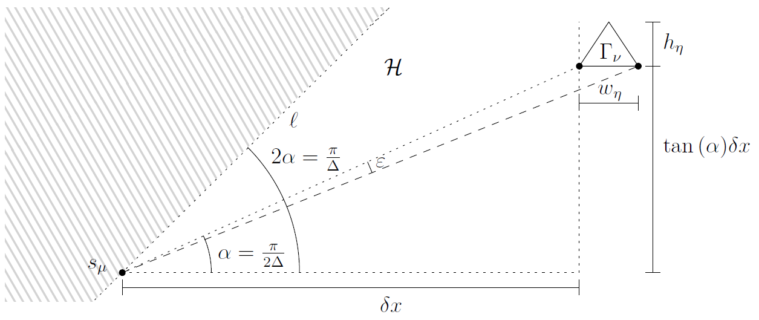
How to draw S*-nodes
τ*
0 < ε < α

Slide 61
How to draw R-nodes

Slide 62
How to draw R-nodes
r ⁺_{2Δ}
r ⁻₂
s_{µ}
t_{µ}
Similar construction as for S*-nodes

Slide 63
Open problems

Slide 64
Open problems
Study the 1-planar s. n. of 1-planar straight-line drawable graphs: Is it bounded in Δ?

Slide 65
Open problems
Study the 1-planar s. n. of 1-planar straight-line drawable graphs: Is it bounded in Δ?
Is the quadratic upper bound for planar s.n. of o1p graphs tight?

Slide 66
Open problems
Study the 1-planar s. n. of 1-planar straight-line drawable graphs: Is it bounded in Δ?
Is the quadratic upper bound for planar s.n. of o1p graphs tight?
Can we draw planar partial 3-trees with o(Δ⁵) slopes and a constant number of crossings per edge?

Slide 67
Open problems
Study the 1-planar s. n. of 1-planar straight-line drawable graphs: Is it bounded in Δ?
Is the quadratic upper bound for planar s.n. of o1p graphs tight?
Can we draw planar partial 3-trees with o(Δ⁵) slopes and a constant number of crossings per edge?
Thank you!

